Slide 1
CUCUMBER FRAMEWORK USING CYPRESS FOR API/UI TESTING
Cuibus Marius

Slide 2
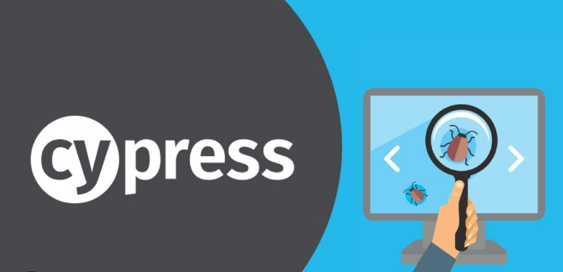
WHAT IS CYPRESS FRAMEWORK?
Is a modern automation testing framework designed for modern web application.
It provides a fast and easy-to-use platform for writing and executing tests in JavaScript/Typescript.
Cypress enables to test the applications by simulating real user interactions, ensuring that the application behaves as expected.
It includes features like real-time reloading, real-time debugging, and automatic waiting, making it a popular choice for automation testing.

Slide 3

WHAT IS CUCUMBER?
Is an open-source tool for Behavior-Driven Development (BDD) used to write and execute tests for software applications.
Cucumber was initially written in the Ruby programming language and provided a way to write tests that anybody can understand, regardless of their technical knowledge. It explains test steps and application behavior using the Gherkin language in simple English.

Slide 4
WHY USE CUCUMBER FOR TESTING?
Cucumber is important as a testing tool for the following reasons:
Cucumber is open-source and free to use
Using Cucumber, QAs can write your test scripts in multiple languages such as Java, Ruby, .NET, Python, etc.
It integrates with Selenium, Ruby on Rails, Cypress, Watir, and other web-based testing tools.
Cucumber is one of the most widely used BDD tools

Slide 5

OVERVIEW OF BEHAVIOR-DRIVEN DEVELOPMENT (BDD)
This approach involves the usage of shared language that enhances communication between various tech and non-tech teams
Tests are more user-focused and based on the system’s behavior
In BDD, “Given-When-Then” is the proposed approach for writing test cases
Focuses on defining ‘behavior’ rather than defining ‘tests’
Enhances communication among the members of cross-functional product teams
Helps reach a wider audience via the usage of non-technical language (Gherkin steps)

Slide 6
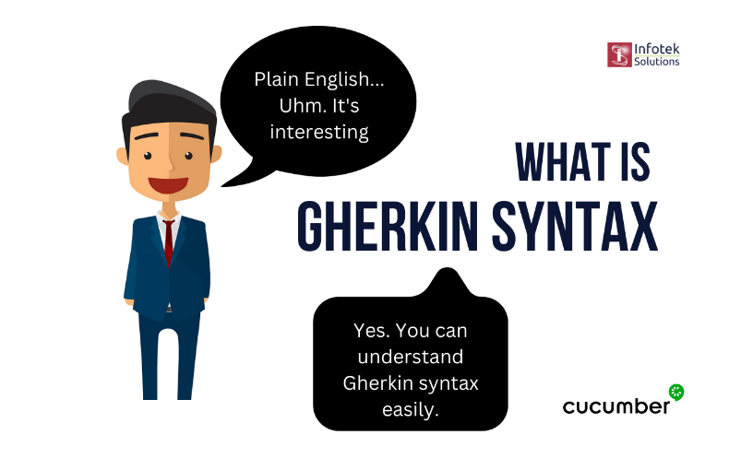
WHAT IS GHERKIN LANGUAGE?
Gherkin is a business readable language which helps you to describe business behavior without going into details of implementation. It is a domain specific language for defining tests in Cucumber format for specifications. It uses plain language to describe use cases and allows users to remove logic details from behavior tests.
Gherkin syntax:
Feature – feature description
Scenario - a description of the scenario of the test case steps
Background – set of steps which are common to all scenarios
Given - steps are used to describe the initial context of the system
When - steps are used to describe an event, or an action
Then - steps are used to describe an expected outcome, or result
And - is a keyword used to combine multiple Given, When, or Then steps in a scenario

Slide 7
HOW TO CONFIGURE THE PROJECT?
1. Install nodejs and add on environment variables
2. Create an empty folder and open the folder from Visual Studio
3. From terminal install the following:
npm install cypress --save -dev (install cypress dependencies)
npm install --save -dev cypress-cucumber-preprocessor (install cucumber dependencies)
npx cypress open (to open cypress for the first time and configure)
4. Update the following files:
add to package.json the stepDefinitions path
add to cypress.config.js the cucumber configuration
add to cypress.config.js the SpecPattern path from what folder do you want to run the tests
after creating the step_definitions file, add on the step definition file the following:
‘import { Given, When, Then} from 'cypress-cucumber-preprocessor/steps’ to use the Gherkin steps from cucumber dependencies file
4. Install the following package on Visual Studio for Cucumber support:
Cucumber (Gherkin) Full Support

Slide 8
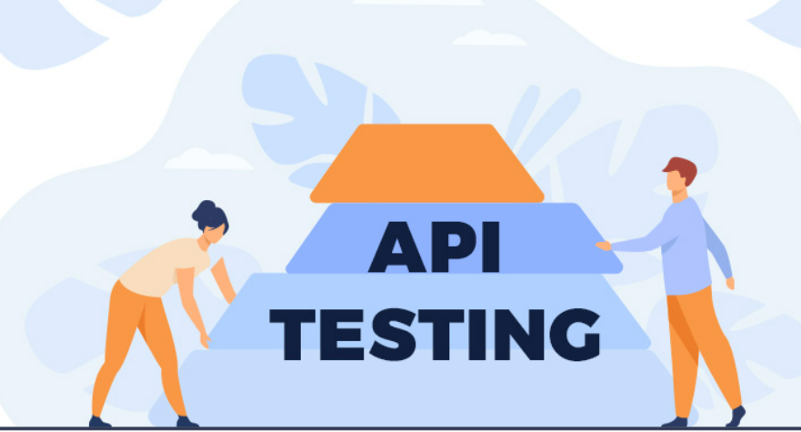
AUTOMATION
API PROJECT STRUCTURE

Slide 9
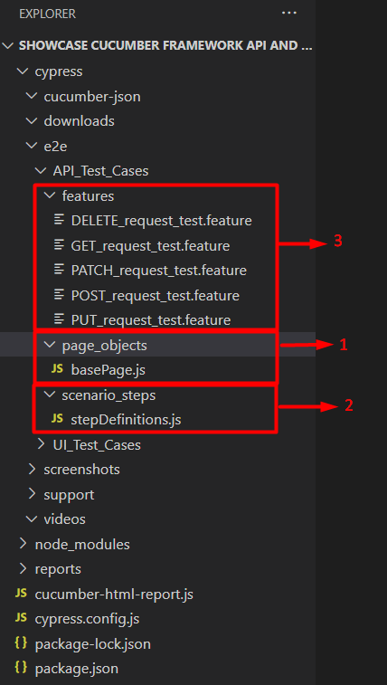
PROJECT STRUCTURE FOR API TESTING
page_objects
basePage.js -> defined common functions which can be used on every feature file and avoid duplication.
scenario_steps
stepDefinitions.js -> are blocks of code that are used to define the behavior of the different steps in a Gherkin scenario. When a Gherkin scenario is executed, the step definitions are responsible for mapping the Gherkin steps to actual code implementation.
features
is a common file which stores features, scenario and feature description to be tested. The feature file is an entry point, to write the cucumber tests and used as live document to the time of testing.

Slide 10

AUTOMATION
UI PROJECT STRUCTURE

Slide 11
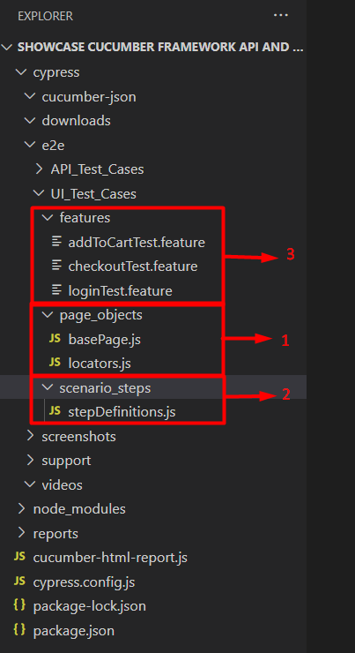
PROJECT STRUCTURE FOR UI TESTING
page_objects
basePage.js -> defined common functions which can be used on every feature file and avoid duplication.
locators.js -> defined the locators
scenario_steps
stepDefinitions.js -> are blocks of code that are used to define the behavior of the different steps in a Gherkin scenario. When a Gherkin scenario is executed, the step definitions are responsible for mapping the Gherkin steps to actual code implementation.
features
is a common file which stores features, scenario and feature description to be tested. The feature file is an entry point, to write the cucumber tests and used as live document to the time of testing.

Slide 12

HOW TO RUN SPECIFIC UI AND API TESTS FROM THE PROJECT

Slide 13
First method
Open the terminal
Run the following command to run the test headed:
npx cypress run --spec [file/folder_relative_path] --headed --browser [browserName]
Run the following command to run the test headless:
npx cypress run –-spec [file/folder_relative_path] --headless
Second method
1. Go on package.json
2. Add the following and save:
"scripts": {
"test_headed": "npx cypress run --spec [file_relative_path] --headed --browser [browserName]",
"test_headless": "npx cypress run --spec [file_relative_path] --headless"
}
3. Open the terminal and run the following command:
npm run test_headed -> which will run the test_headed script
npm run test_headless -> which wll run the test_headless script

Slide 14
Third method
Open the terminal
Run the following command to run the test headed:
npx cypress open
Choose E2E Testing
Chose the browser where you can runthe tests
Select the feature file to run the tests (the test will be run headed)

Slide 15
HOW TO RUN ALL THE TESTS FROM THE PROJECT

Slide 16
First method
Open the terminal
Run the following command to run the test headed:
npx cypress run --headed --browser [browser_name]
Run the following command to run the test headless:
npx cypress run --headless
Second method
1. Go on package.json
2. Add the following and save:
"scripts": {
"test_headed": "npx cypress run --browser [browser_name]",
"test_headless": "npx cypress run --headless"
}
3. Open the terminal and run the following command:
npm run test_headed -> which will run the test_headed script
npm run test_headless -> which wll run the test_headless script

Slide 17
VIDEOS AND SCREENSHOTS ARE GENERATED AFTER RUNNING THE TESTS HEADLESS/HEADED

Slide 18
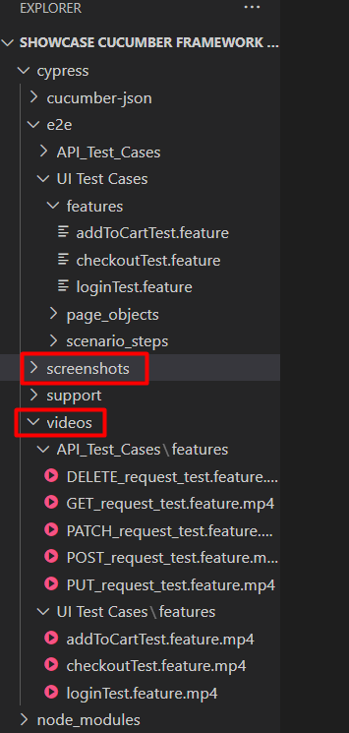
Please note that after the tests are run headed/headless the following are created:
1. Videos of every run test cases if the scenarios have passed testing
2. Videos of the run test cases and also screenshots if the scenarios have failed testing

Slide 19

HOW TO GENERATE A HTML REPORT WITH THE TEST RESULTS

Slide 20
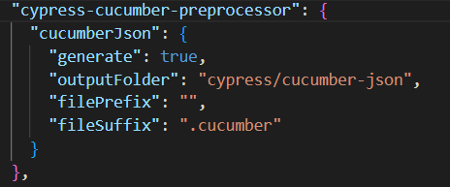
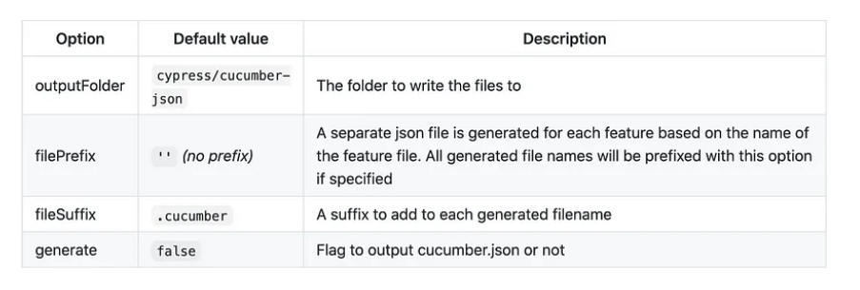
Steps:
Add below lines in package.json under cypress-cucumber-preprocessor section.
Details:

Slide 21
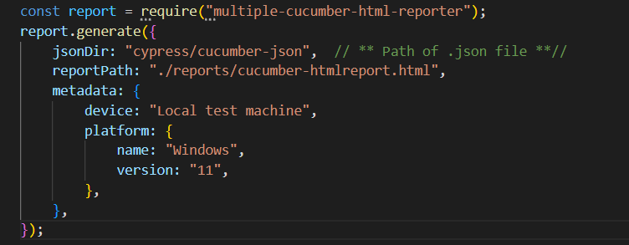
Steps:
2. Install the following plugin:
npm install multiple-cucumber-html-reporter --save-dev
3. Create cucumber-html-report.js which it will help you to read the .json file under cypress/cucumber-json which will be generated after the tests are run. In the cucumber-html-report.js write the following:

Slide 22
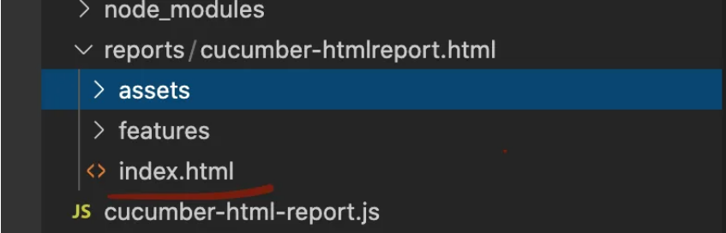
4. Delete the previous files generated on cypress/cucumber-json
(I’ve created a script for this in my project)
5. Run the tests
6. Generate the cucumber.html report by running the following command: node cucumber-html-report.js
(I’ve created a script for this in my project)
7. The report is generated on the following path in the project: ./reports/cucumber-htmlreport.html -> index.html

Slide 23
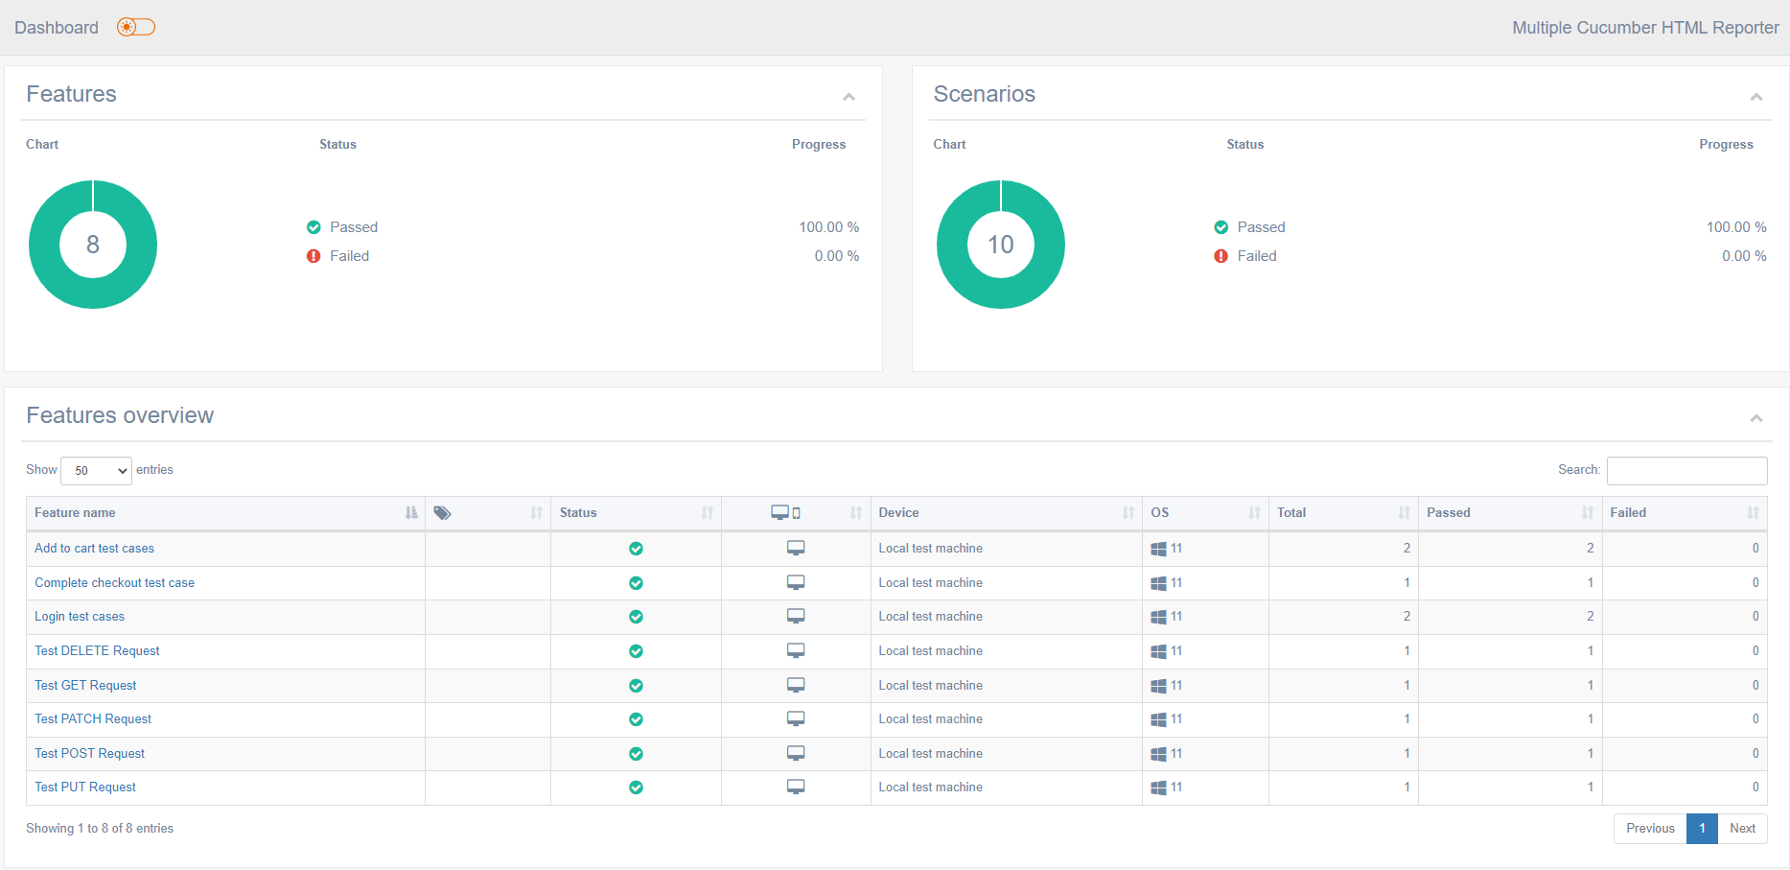
8. Open the index.html file file in browser and see the report

Slide 24

DEMO

Slide 25
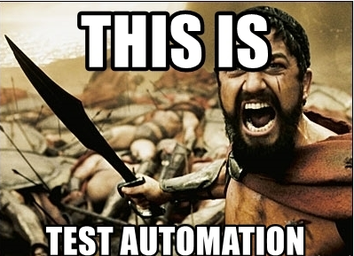
THANK YOU

